Slide 1
How Mad is March Madness?
Lance Bowman

Slide 2




Division I

Slide 3
— Henry V. Porter
“A little March madness may complement and contribute to sanity and help keep society on an even keel.”
When talking about the tournament in 1939
Notes:
- Porter coined the term, Musberger popularized it in the 1980’s during CBS broadcasts of the tourney, now describes the tournament

Slide 4
Viewership
Data courtesy Statista
Notes:
- Viewership across the average game has always been high – lowest since 2013 was 2016, which had the best national championship in awhile. That + casual viewing equals…

Slide 5


Bracketology
Joe Lunardi
Creator of NCAA Tournament Bracketology, ESPN
Warren Buffett
Chairman & CEO, Berkshire Hathaway
Notes:
Bracketology; people’s innate desires + Joe Lunardi + Warren Buffett’s offers = even the most casual fan delving into it. How many?

Slide 6
Bracketology – By the Numbers
20,000,000+
Brackets filled out on ESPN’s online services alone in 2023
~26,000
The number of brackets entered per minute during ESPN’s peak entry period
Notes:
20M filled out in 2023 alone on THEIR service, including a peak of 26K. This does not include Yahoo, CBS, NCAA, or paper entries. With that many being filled out…

Slide 7
How has there not been a perfect bracket?

Slide 8
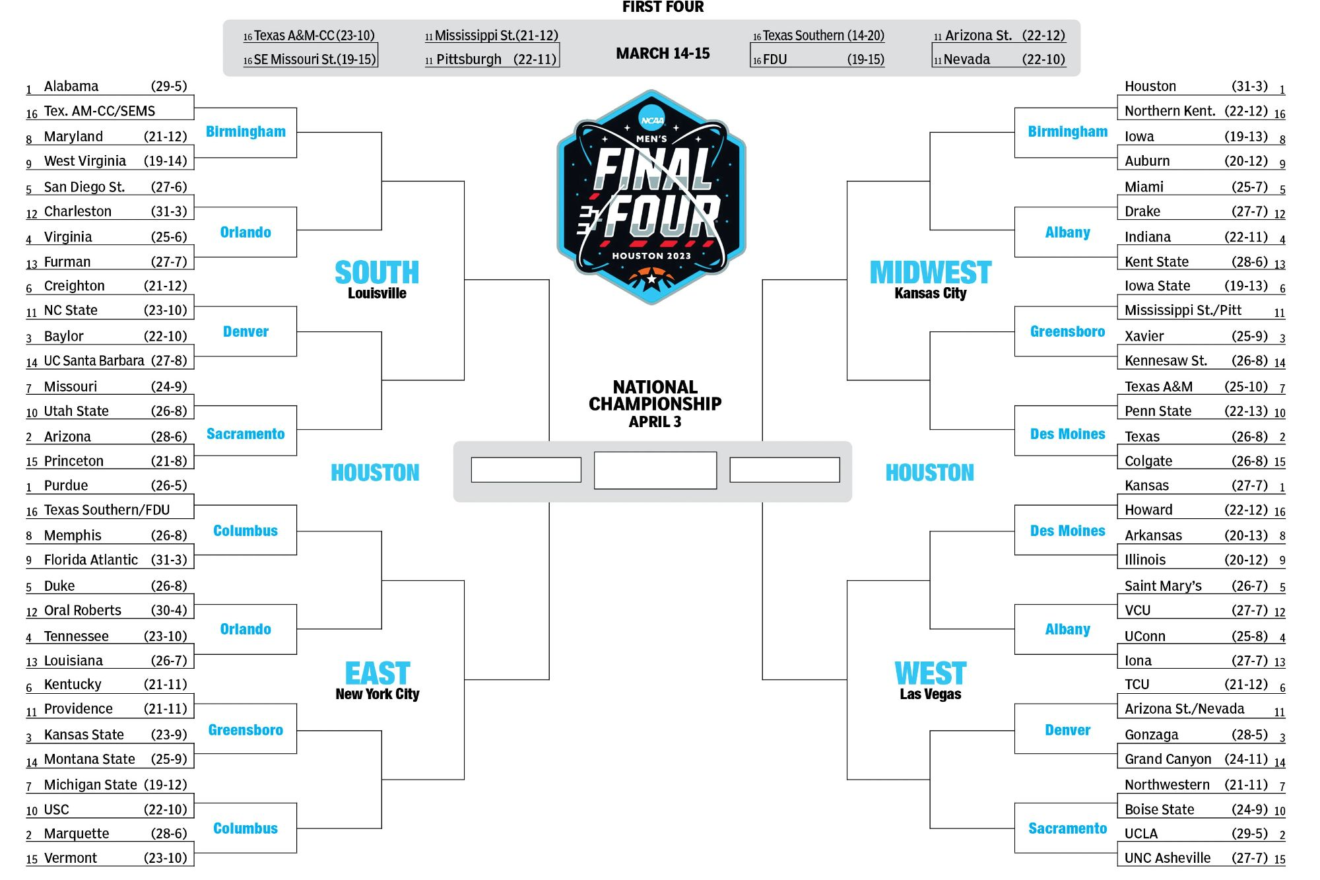
Notes:
Bracket explanation – selection by committee (all 64 teams, ignoring play-ins), ordered by quality of team and divided into 4 regions. Probability?

Slide 9
Bracketology – By the Numbers
9,223,372,036,854,775,808
20,000,000+
The number of possible brackets in the tournament
Brackets filled out on ESPN’s online services alone in 2023
~26,000
The number of brackets entered per minute during ESPN’s peak entry period
Notes:
That big ole number, 2 to the 63rd, or

Slide 10
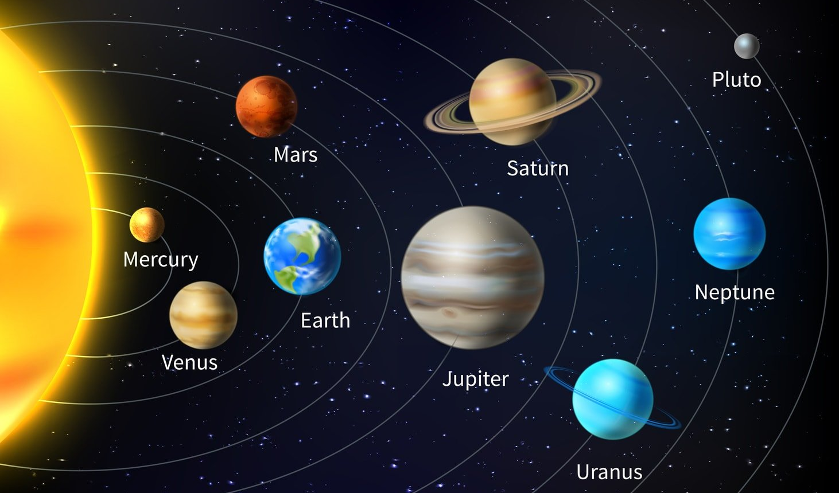

60x
Notes:
The earth to pluto in dollar bills 60x over.

Slide 11
Bracketology – By the Numbers
~128 billion
9,223,372,036,854,775,808
20,000,000+
The number of possible brackets in the tournament
Brackets filled out on ESPN’s online services alone in 2023
with more info
~26,000
4,294,967,296
The number of brackets entered per minute during ESPN’s peak entry period
The number of possible selections for the Round of 64
Notes:
Therefore, our odds are not great. Even if we know about basketball, it’s still 1 in 128B. Paring it down to 1st round only, it’s about 4 billion.

Slide 12
Therefore…
Our goal is not to predict an entire bracket perfectly, let alone the first round perfectly, but to predict the first round the best we can.
We will utilize R and Tableau to do so.
Notes:
Therefore…

Slide 13
The Data - Fields Explained
Traditional
Advanced
Adjusted
The usual rate stats and categorical information
Lesser-known stats that are not found in the box score
How does a team perform against the real average?
No suffix
_R64Opp
_SznOpp
_Diff_R64Opp
_Diff_SznOpp
The statistic for the current team
The statistic for the current team’s opponent in the Round of 64
The statistic for the current team’s opponents through the season
No suffix –
_R64Opp
No suffix –
_SznOpp
Notes:
Explained further

Slide 14
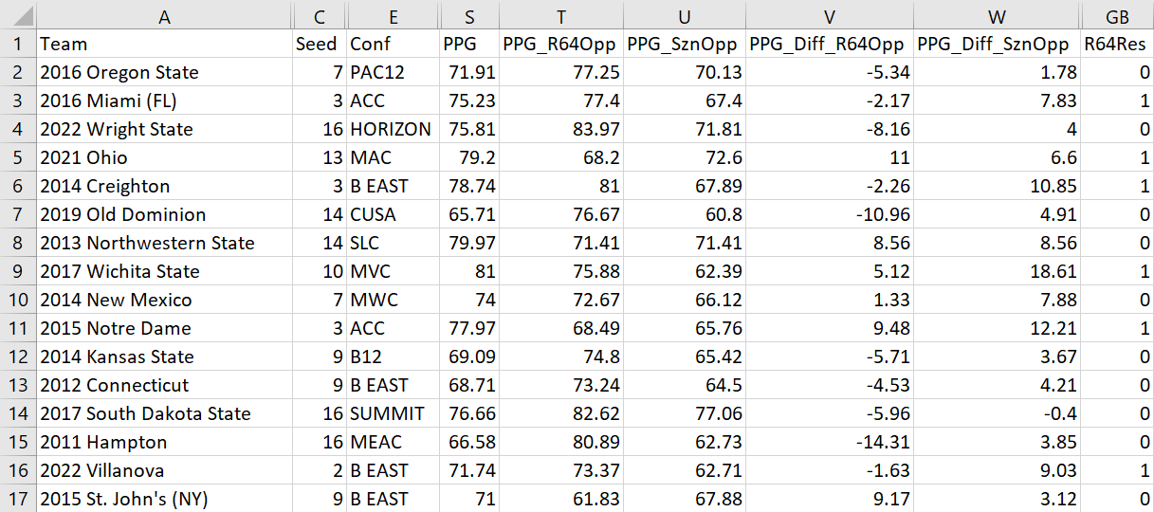
The Data – An Example
Notes:
Explained further once more.

Slide 15
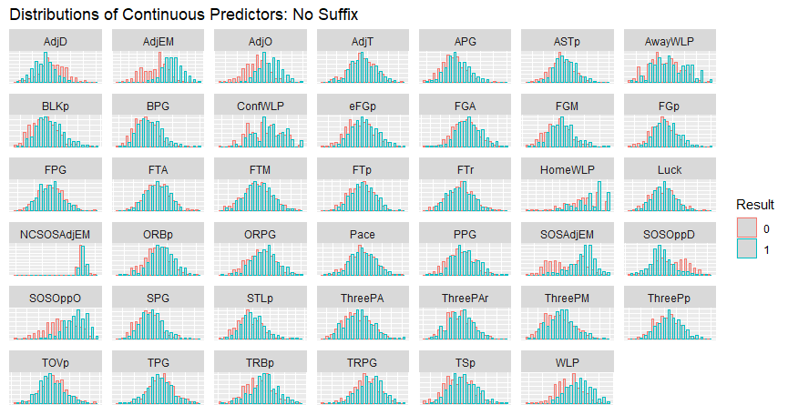
Notes:
Predictors for no suffix – 6 KenPom stats stand out, and we’ll get to those soon
(Nothing notable for R64Opp or SznOpp)

Slide 16
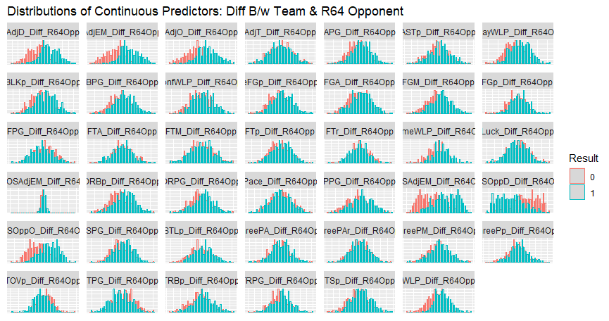
Notes:
Predictors for the difference between a team and their R64 opponent are the best we’ve seen and are definitely going to be used later. KenPom stats still the best, with others looking interesting.
(Nothing notable for Diff_SznOpp)

Slide 17
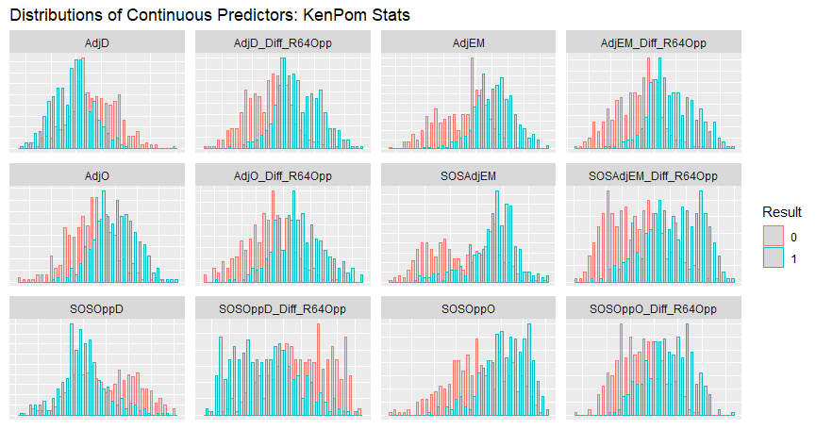
Analysis – Best Predictor(s)
Notes:
We want one predictor, like most people. So, what stood out? As we earlier mentioned, the KP stats and the difference between a team’s and their R64 opponents was best after some digging

Slide 18

What is AdjEM?
Adjusted Offensive Efficiency (AdjO):
Amount of points a team scores per 100 possessions against the average
Adjusted Defensive Efficiency (AdjD):
Amount of points a team allows per 100 possessions against the average
Adjusted Efficiency Margin (AdjEM):
AdjO – AdjD; how much a team “outperforms” the average
Ken Pomeroy
Creator of KenPom archive
Notes:
What is AdjEM? Why’s it important?

Slide 19
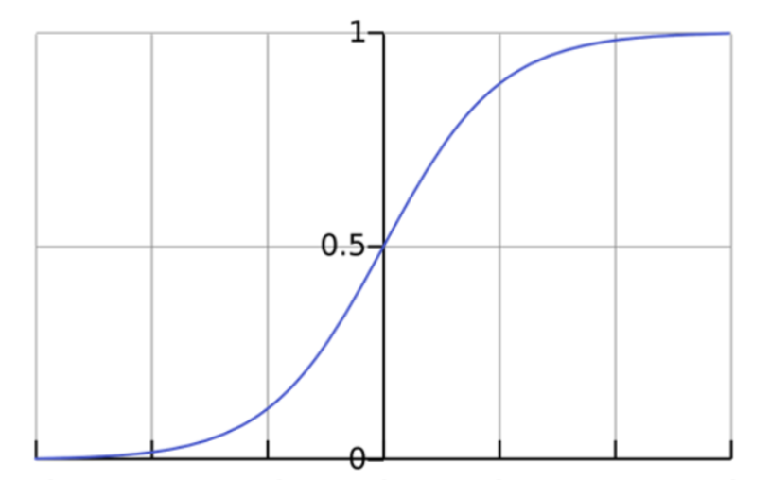
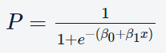
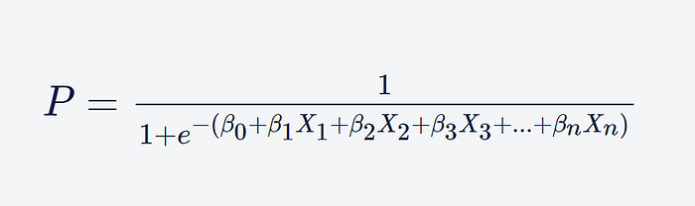
A Sidebar on Logistic Regressions
What is it?
How is this done?
And all the resulting values (probabilities) fall between 1 and 0.
A machine learning algorithm; predicts the probability that an instance belongs to a specific classification, given the predictors, outputting a probabilistic value between 0 and 1
It uses the logistic function, where P is mapped as a sigmoid function of a predictor and the intercepts…
Multiple predictors can be inserted into the sigmoid function if necessary.
Notes:
A sidebar on logistic regressions, since that’s the tool we’ll use mostly

Slide 20
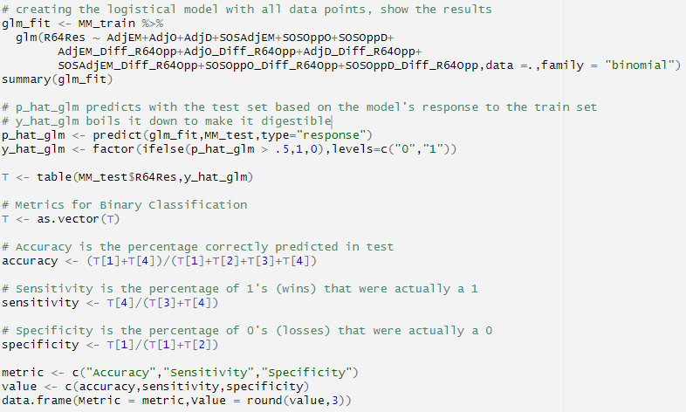
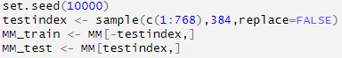
Analysis – First Logistic Regression (Code)
Notes:
We split the data evenly so as to avoid bias & overfitting, and we now look at our first logistic regression, throwing in all 12 variables from earlier. This is how it’s done, as well as MBC’s.

Slide 21
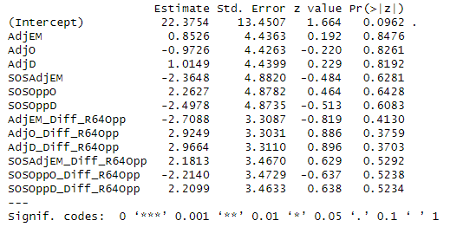
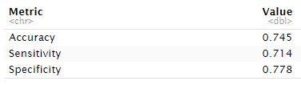
Analysis – First Logistic Regression (Results)
Notes:
No statistical significance yet, and our predictions from a metric standpoint aren’t amazing. Diff variables are much better with p-values, so we’ll roll with just those

Slide 22
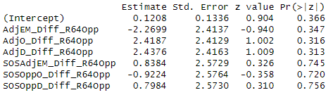
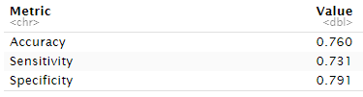
Analysis – Logistic Regression (KenPom 6, Diff R64)
Notes:
Still no statistical significance, but our metrics are improving. 3 stand out again, so we cut them out

Slide 23
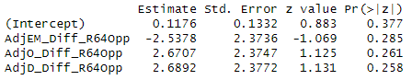
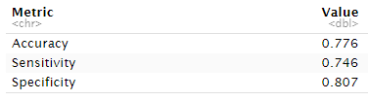
Analysis – Logistic Regression (KenPom 3, Diff R64)
Notes:
Still no statistical significance, but our metrics are improving further. Now would be where I would just cut out the larget p-value, but we know the relationship between AdjEM and AdjO/D. Let’s see them each in their own models.

Slide 24
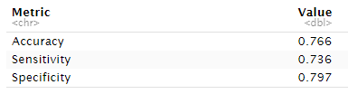
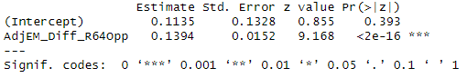
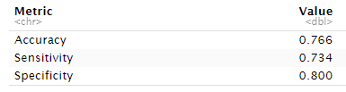
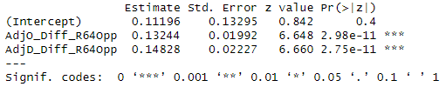
Analysis – Logistic Regression (AdjEM/O/D, Diff R64)
Difference in AdjEM b/w Team & Round of 64 Opponent
Difference in AdjO and AdjD b/w Team & Round of 64 Opponent
Notes:
We’re finally where we wanna be. Statistical significance + still-good metrics, and they’re incredibly similar. Go with difference in AdjEM. It’s TRUSTWORTHY and CORRECT AS CAN BE.

Slide 25
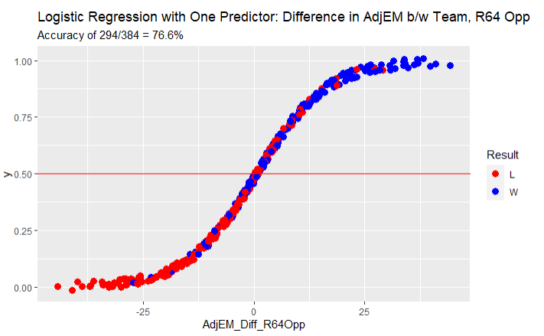
Analysis – Logistic Regression (AdjEM, Diff R64)
Notes:
A graph for AdjEM.

Slide 26


Analysis – Conferences
“High-Major”
“Mid-Major”
Notes:
Being a basketball fan has shown how conferences are treated and respected differently – and they should be. Ex: SEC and Sun Belt play in same region. Explanation of high-major

Slide 27
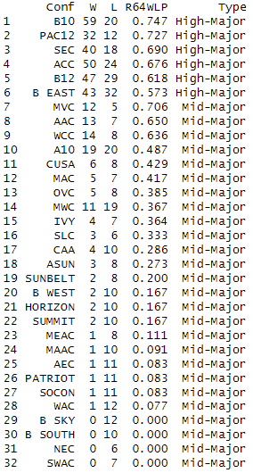











Analysis – Conferences
2
5
2
2
3
4
12
2
Notes:
Likewise, here are all the conference’s records in the first round. Note MVC, AAC, and WCC being only mid-majors better than a high-major – that is explained by powerhouses that moved on, as only WCC’s are left

Slide 28
Analysis – Conferences
Notes:
We also have to be careful of the two mid-majors with the most appearances, as they are under .500, being inconsistent…

Slide 29
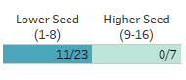
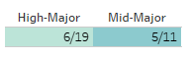
Analysis – Conferences (Mountain West)
Based on the team’s seed:
Based on the opponent’s conference:
Notes:
The Mountain West being almost consistently bad against high-major talent.

Slide 30







Analysis – Conferences (Matchups)
vs.
vs.
4
4
4
3
vs.
vs.
4
3
6
0
vs.
vs.
1
6
2
4
Notes:
As for conf v conf matchups, these are the most common ones. The only standouts are Big East v Big South (6-0) and ACC v Big 10 (1-6).

Slide 31
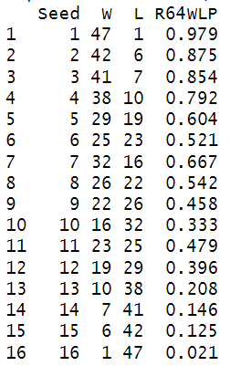
Analysis – Seeds
Note:
1) Symmetry of Win-Loss Percentage
2) Win-Loss Percentage doesn’t decrease every time
Notes:
Now we go on to seeds. 2 items pop up: symmetry of WLP (meh), and the WLP does not always decrease (?). Regardless, we start our discussion with…

Slide 32
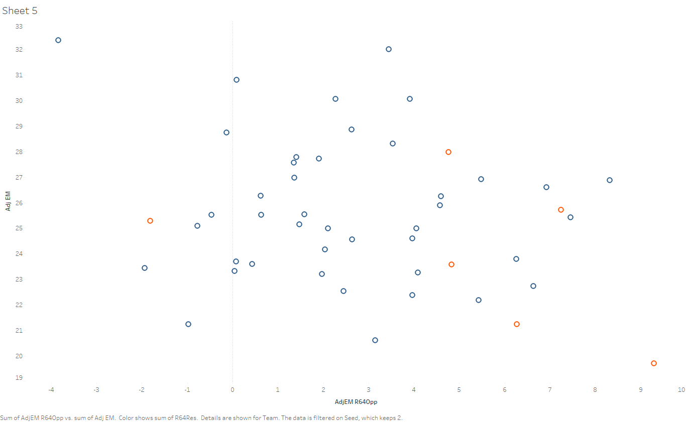
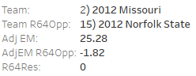
Analysis – Seeds (2 Seeds, AdjEM)
Notes:
2 seeds. They only need to worry when their 15 seed opponent is under 4, with only one loss ever – Missouri v Norfolk St, the same outlier from earlier

Slide 33
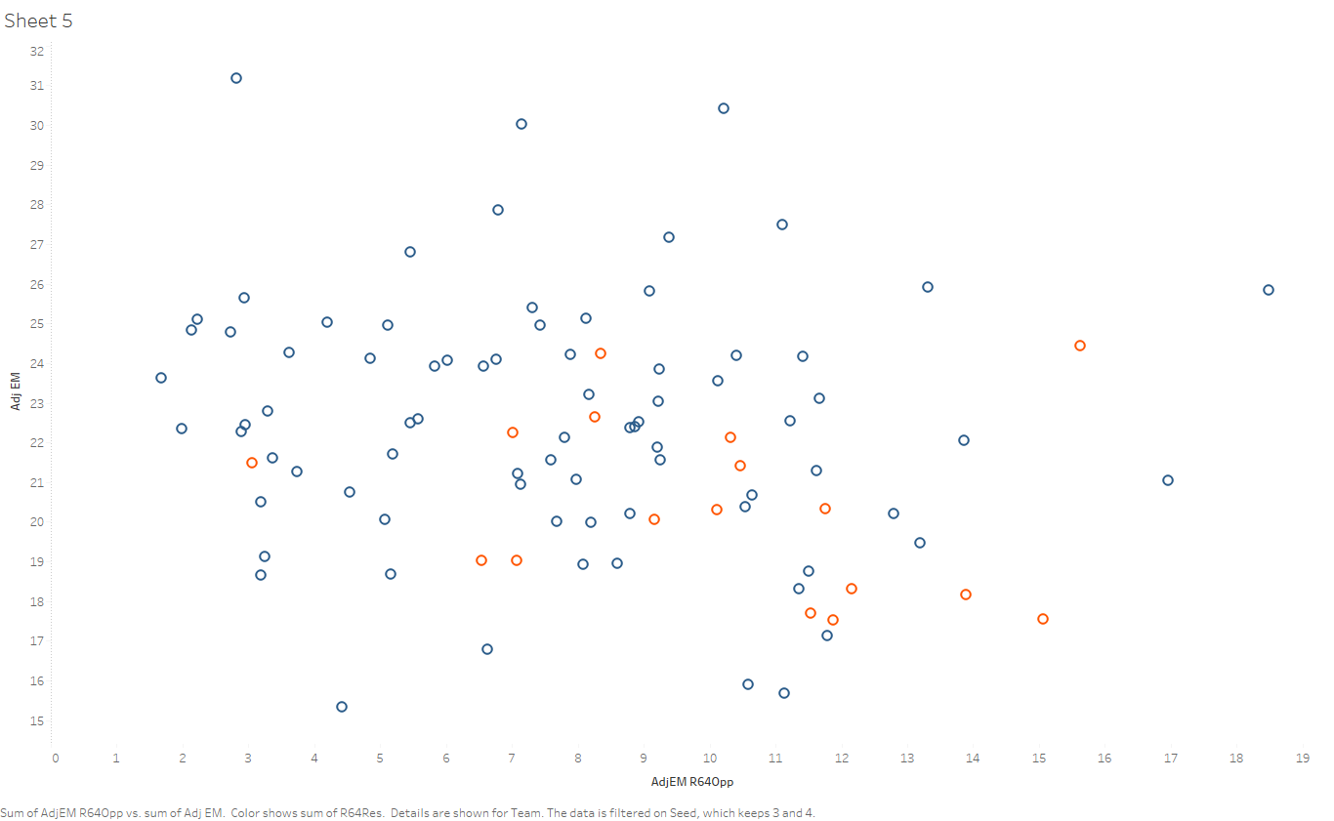
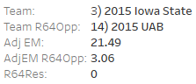
Analysis – Seeds (3 & 4 Seeds, AdjEM)
Notes:
We move on to 3 and 4 seeds, and a clear pattern emerges – when a team has an AdjEM over 25 or their opponent’s is below 6, a win has occurred in all cases but Iowa St’s loss to UAB in 2015 (38-1).

Slide 34
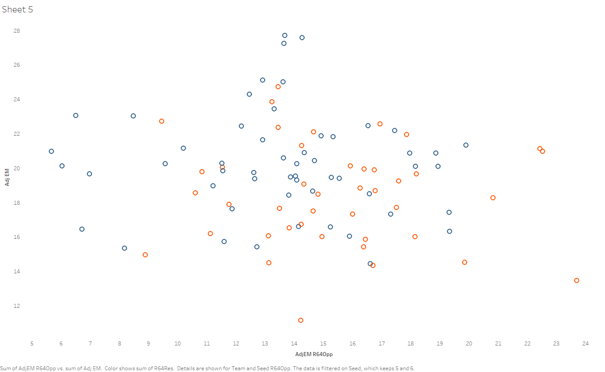
Analysis – Seeds (5 & 6 Seeds, AdjEM)
Notes:
All that being said, I sadly couldn’t find much for seeds 5 or 6. Other than a general propensity for the better team winning, not much was there.

Slide 35
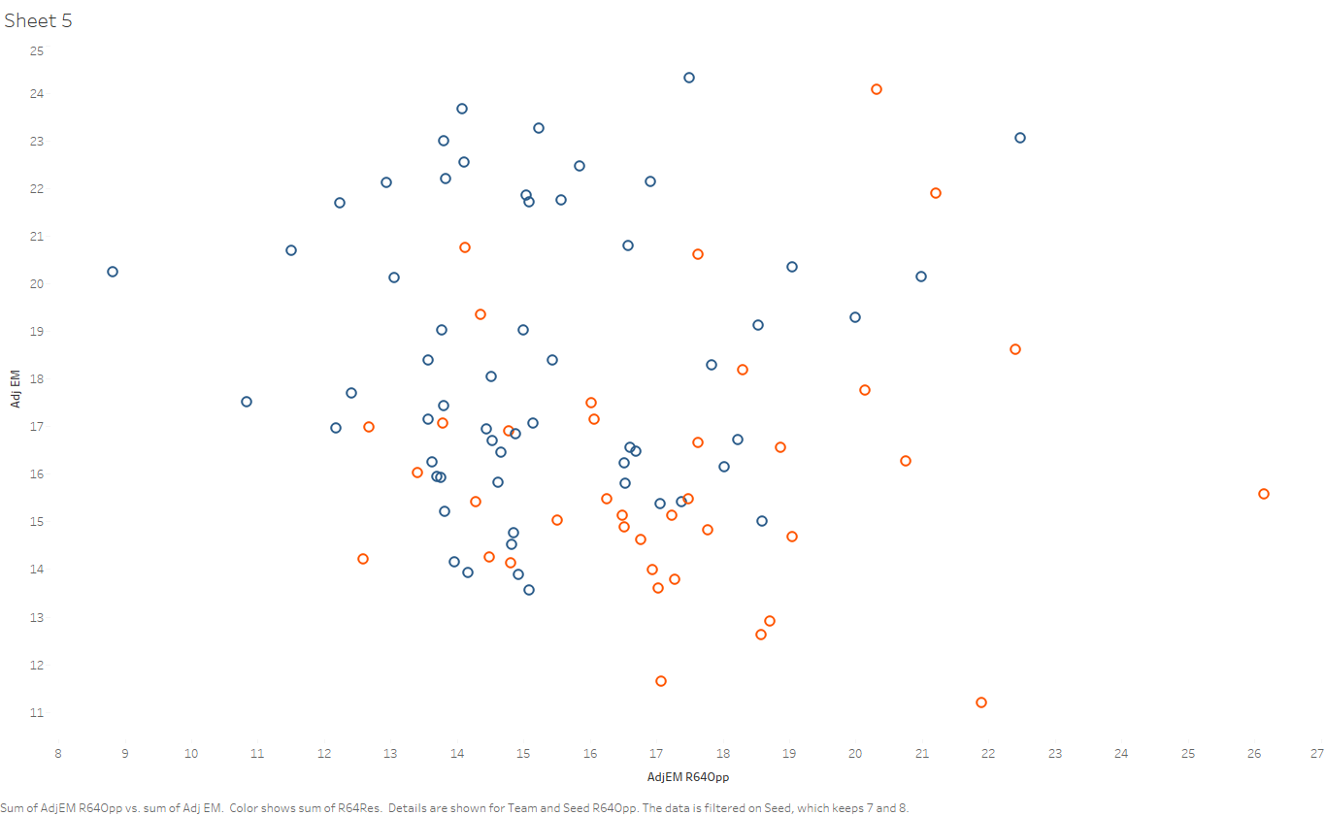
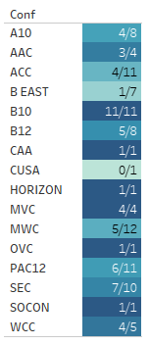
Analysis – Seeds (7 & 8 Seeds, AdjEM + Last Note)
A Big 10 team has not lost as a 7 or 8 seed since 2010 through 11 appearances.
Notes:
As for the 7 and 8 seed, a lot happens depending on the team’s AdjEM; those above are 28-7, while those below are 30-31. Not a death knell, but work looking at.

Slide 36
Analysis – Conferences (1 Seeds)?
Notes:
Am I going to talk about 1 seeds? No.

Slide 37
Conclusion:
Adjusted Efficiency Margin – or more specifically, the difference between a team’s and their opponent’s – is the best overall option for determining a winner. However, there are a few stipulations to watch out for.
Notes:
Conclusion + stipulations of…

Slide 38
Conclusion - Stipulations
High-major conferences perform better in the first round on average, and…
Mountain West
Big 10
AdjEM matters per seed, and…
1 seed
2 seed
3 or 4 seed
5 or 6 seed
7 or 8 seed
Notes:
Explained further.

Slide 39
How would we do with 2023’s bracket?
Notes:
The whole point was for bracketology. How would we do?

Slide 40
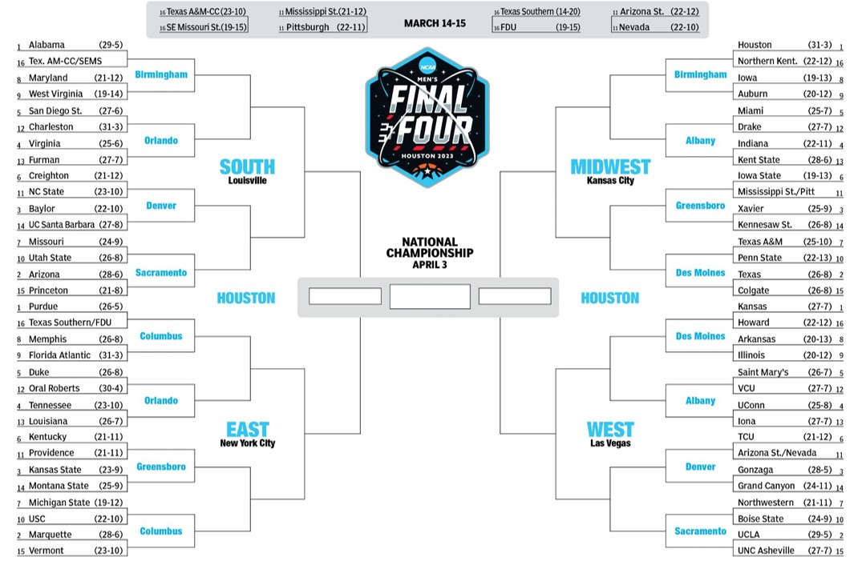
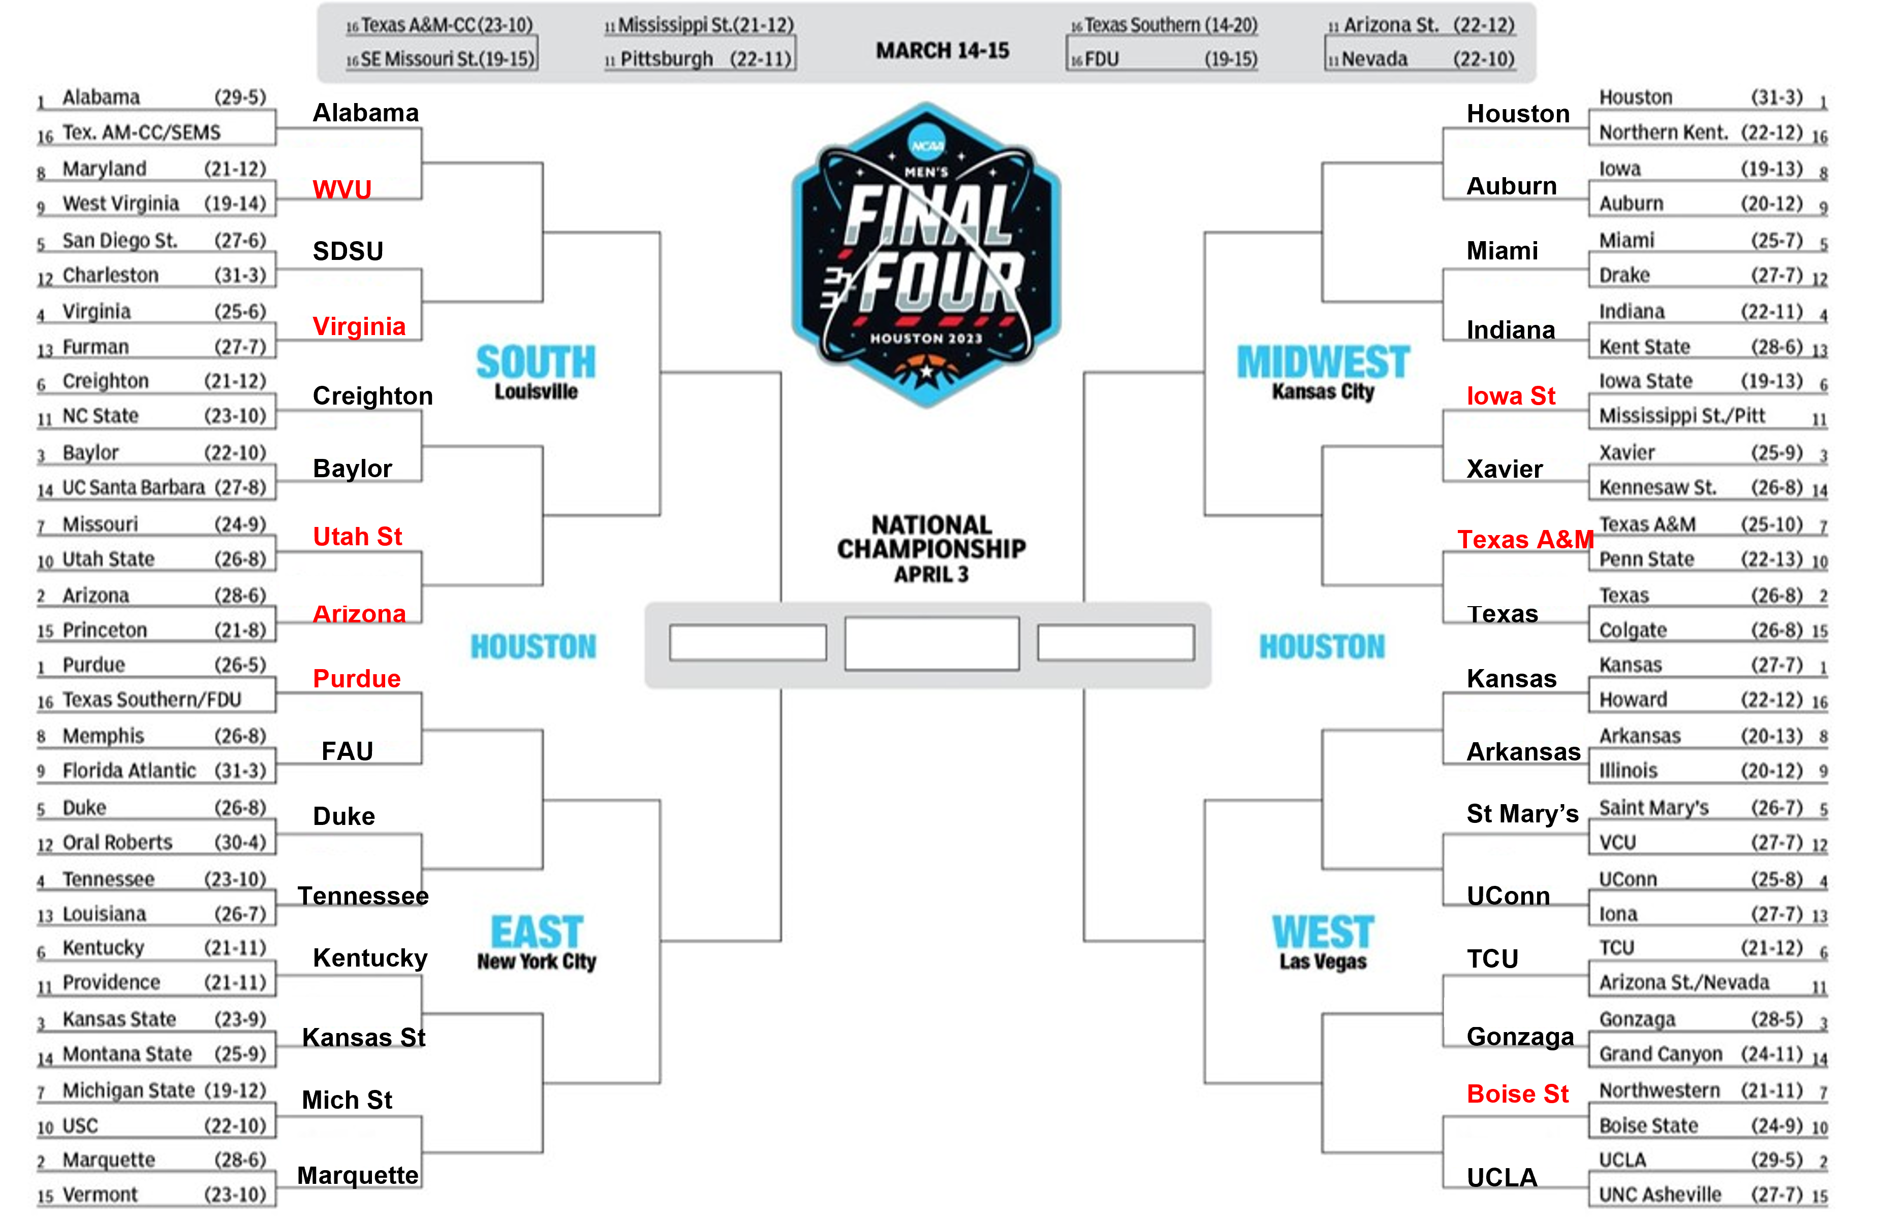
Virginia AdjEM: 16.37 < 25
Furman AdjEM:
8.01 > 6
Utah State – Mountain West,
Missouri - SEC
Texas A&M AdjEM:
16.71 < 18
Princeton AdjEM:
8.04 > 4
Boise State – Mountain West AND 10 seed,
Northwestern – Big 10 AND 7 seed
Notes:
Here’s how we’d do just going off of AdjEM. Not bad, but 24/32 isn’t much better than how I did (22/32). However, the majority of these failures have a stipulation that could be applied.

Slide 41
Resources, 1-5
Batra, Rohit. “Logistic Regression Algorithm in Just 4 Steps! | by Rohit Batra | Medium.” Medium, Medium, 13 Mar. 2022, https://medium.com/@rohit_batra/logistic-regression-algorithm-in-just-4-steps-16f34617c03c.
Camenker, Jacob. “Why Is It Called March Madness & When Did It Start? The Story behind NCAA Tournament Origins | Sporting News.” Sporting News - NFL | NBA | MLB | NCAA | Boxing | Soccer | NASCAR, 16 Mar. 2021, https://www.sportingnews.com/us/ncaa-basketball/news/ncaa-tournament-why-its-called-march-madness-start/1eaonc5ckv33k194gbtnryc28s.
DePaul University Marketing & Communications. Odds of a Perfect NCAA Basketball Bracket - DePaul Expert, Professor Jeff Bergen. YouTube, 29 Feb. 2012, https://www.youtube.com/watch?v=O6Smkv11Mj4.
Hartzler, Lance. “Let’s Talk about It: What Do We Consider a Mid Major? - Mid-Major Madness.” Mid-Major Madness, Mid-Major Madness, 6 Nov. 2022, https://www.midmajormadness.com/2022/11/6/23439653/fun-with-labels-whats-a-mid-major-in-college-basketball-really-i-dont-know.
Huddleston, Tom. “Inside Warren Buffett’s Multimillion-Dollar March Madness Challenge.” CNBC, CNBC, 21 Mar. 2019, https://www.cnbc.com/2019/03/21/inside-warren-buffetts-multimillion-dollar-march-madness-challenge.html.

Slide 42
Resources, 6-10
“Men’s and Women’s College Basketball Statistics and History | College Basketball at Sports-Reference.Com.” College Basketball at Sports-Reference.Com, Sports Reference, https://www.sports-reference.com/cbb/. Accessed 11 Oct. 2023.
Morse, Ben. “March Madness Bracket: The Astronomical Odds of Selecting a Perfect Bracket | CNN.” CNN, CNN, 13 Mar. 2023, https://www.cnn.com/2023/03/13/sport/march-madness-perfect-bracket-odds-spt-intl/index.html.
Ota, Kevin. “ESPN Tournament Challenge Sets New All-Time Record: 20 Million Brackets - ESPN Press Room U.S.” ESPN Press Room U.S., https://www.facebook.com/ESPN, 16 Mar. 2023, https://espnpressroom.com/us/press-releases/2023/03/espn-tournament-challenge-sets-new-all-time-record-20-million-brackets/#:~:text=ESPN%20Tournament%20Challenge%20Sets%20New%20All%2Dtime%20Record%3A%2020%20Million%20Brackets,-Kevin%20Ota%20Follow&text=The%20ESPN%20Men’s%20Tournament%20Challenge,most%20ever%20for%20the%20No.
Pomeroy, Ken. “Pomeroy College Basketball Ratings.” KenPom.Com, https://kenpom.com/. Accessed 11 Oct. 2023.
Ruiz, Steven. “Villanova-UNC Was the Best NCAA Championship Game Ever | For The Win.” For The Win, For The Win, 5 Apr. 2016, https://ftw.usatoday.com/2016/04/villanova-unc-tops-the-list-of-the-10-best-ncaa-championship-games-ever.

Slide 43
Questions?
Notes:
The whole point was for bracketology. How would we do?

